Slide 1
Observer Design Pattern
(Behavioral Design Pattern)
Page-75

Slide 2
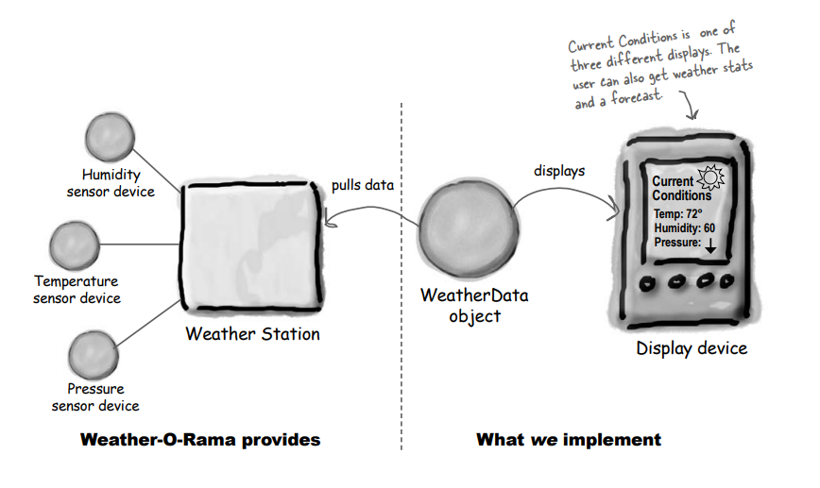
The Weather Monitoring application overview
The three players in the system are the weather station (the physical device that acquires the actual weather data), the WeatherData object (that tracks the data coming from the Weather Station and updates the displays), and the display that shows users the current weather conditions.

Slide 3
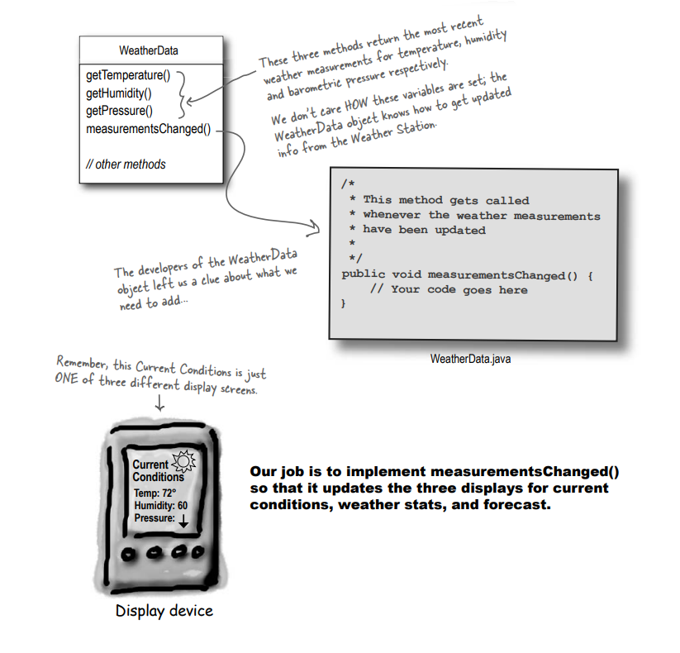
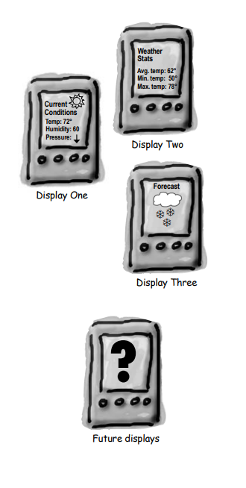
Current Code Structure and Display Format
We want to make the system expendable

Slide 4
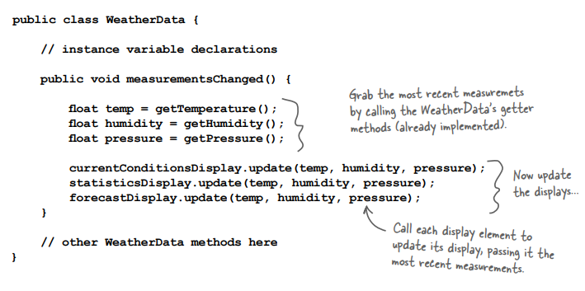
Current Code status

Slide 5
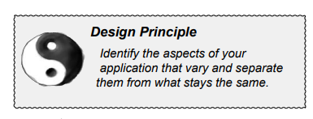
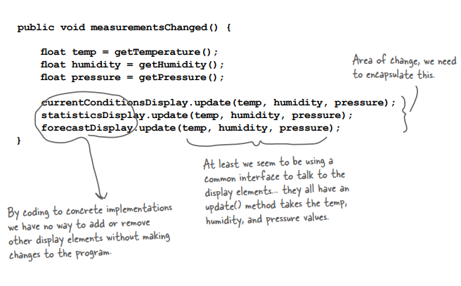
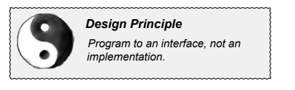
Current Issues & Applicability of design principles

Slide 6
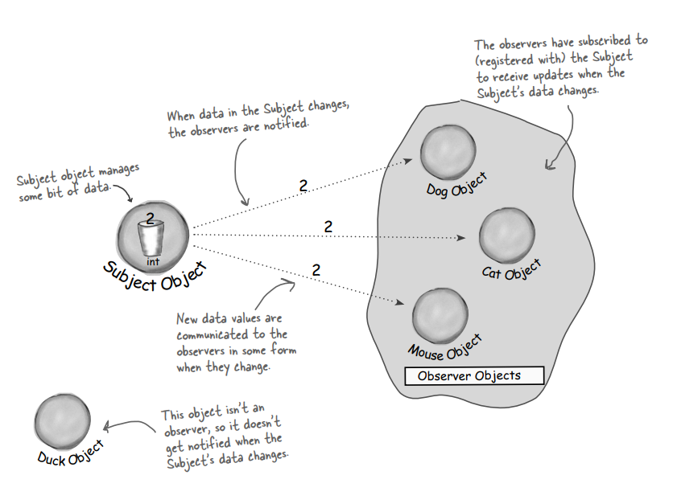
Publisher (Subject) + Subscriber (Observer) = Observer Pattern
Basic operations
Subscribe/register an observer
Notify the observers of an update
Unsubscribe/unregister an observer
(Publisher)
(Subscribers)

Slide 7
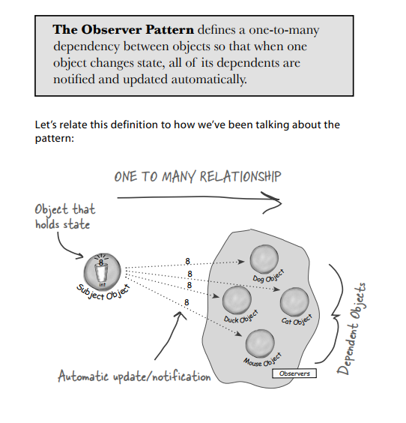
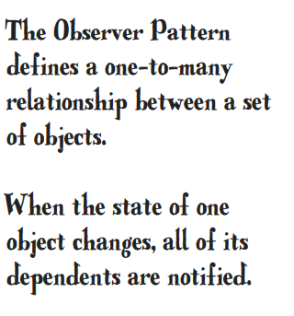
Purpose of Observer Pattern

Slide 8
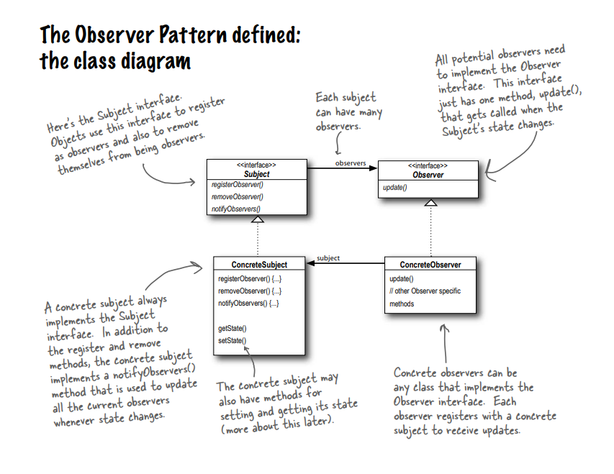

Slide 9
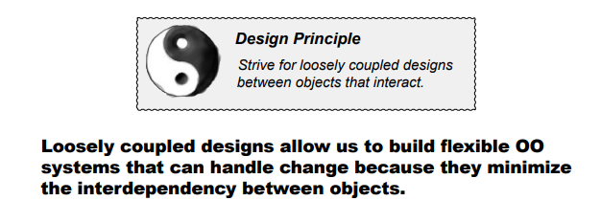
The Observer Pattern provides an object design where subjects and observers are loosely coupled.
When two objects are loosely coupled, they can interact, but have very little knowledge of each other
The power of loose coupling

Slide 10
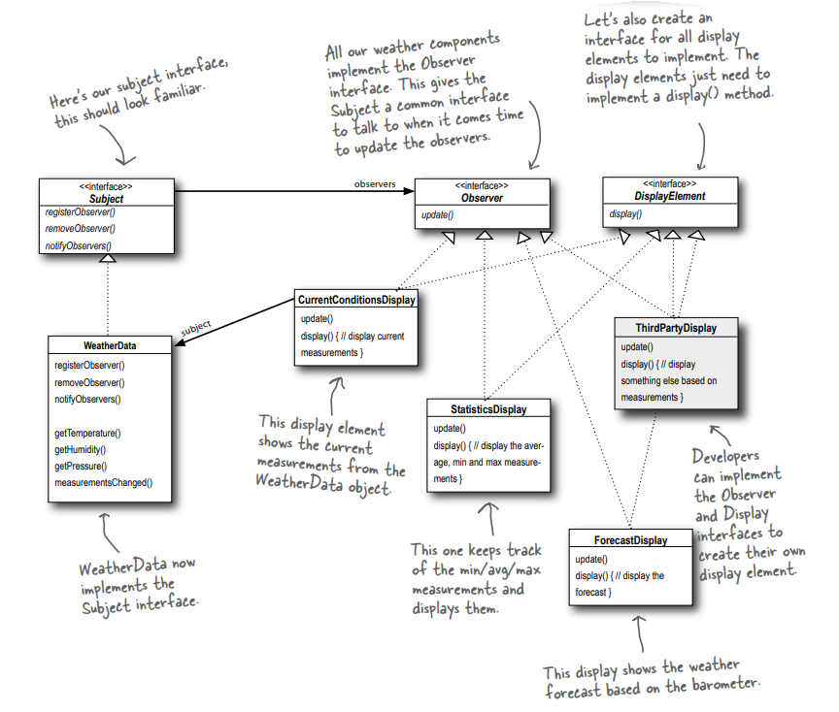
A possible solution of the problem
All the observers has a “subject” to hook upon
The subject “observes” all the observers

Slide 11
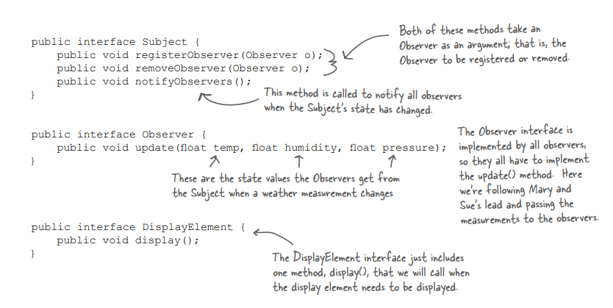
Implementation

Slide 12
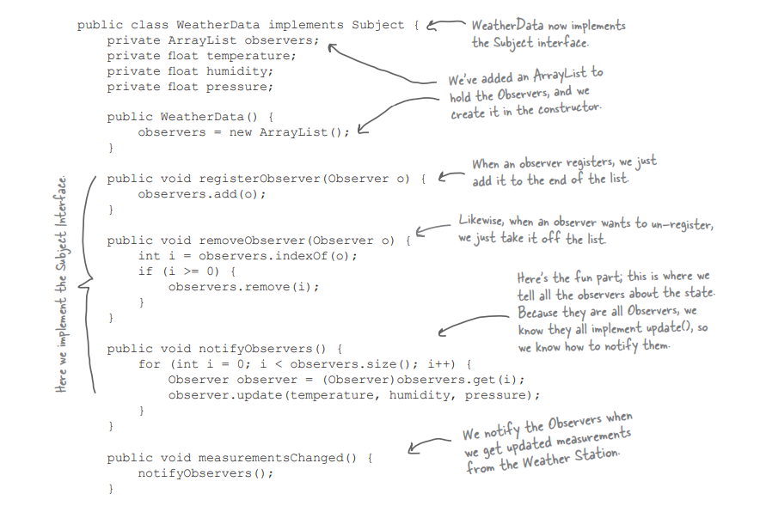
Private elements
Implementing the Subject interface in WeatherData - 1
Without being specific to a particular observer, we can directly work on each.

Slide 13
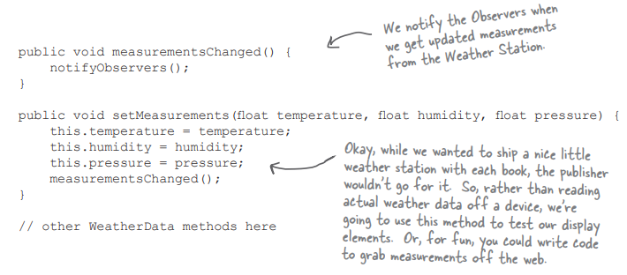
Implementing the Subject interface in WeatherData - 2
Remaining portion of the previous class

Slide 14
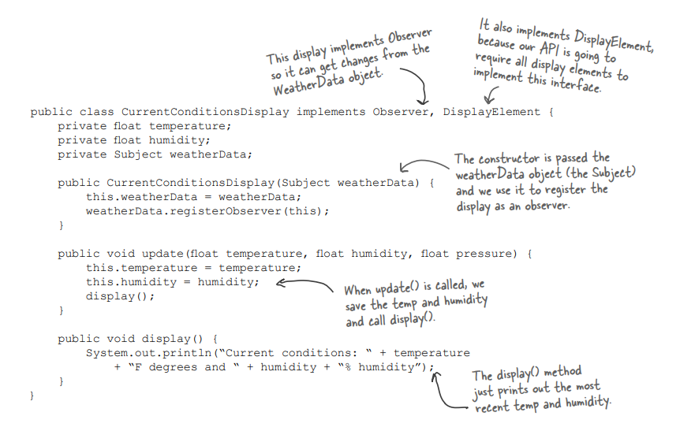
Implementing the observers

Slide 15
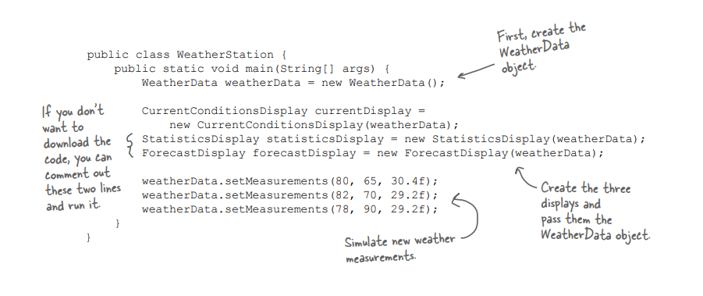
Link
The Main Code

Slide 16
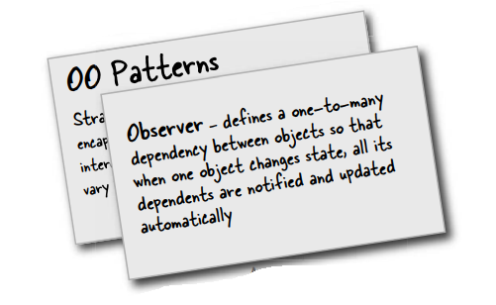
Summary

